Slide 1
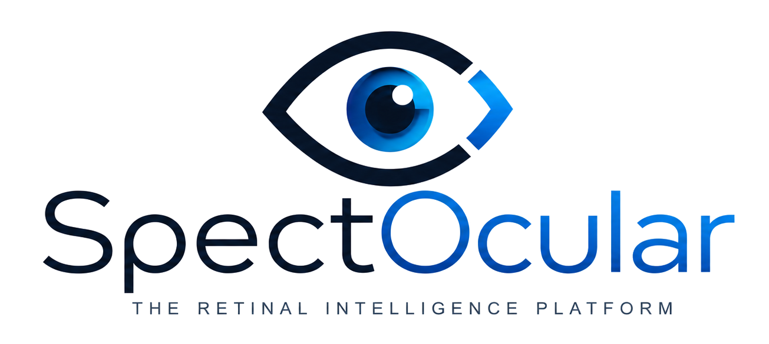

Retinal intelligence for systemic disease
A platform company built from routine retinal imaging.
Retina IQ installs the network. The evidence engine proves the signal. The first authorization validates the platform.
August 2026 · Confidential · Live pitch v5.1

Slide 2
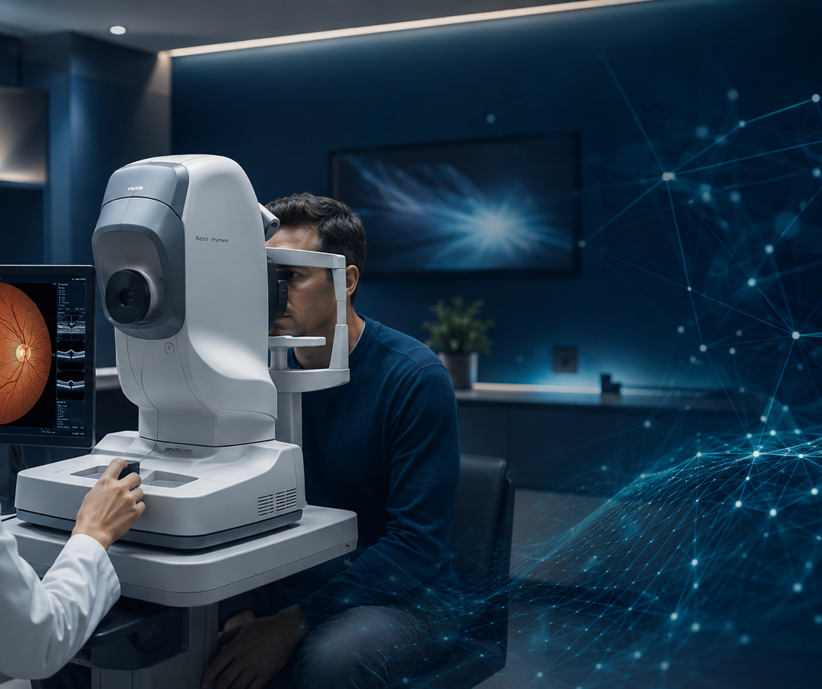
Retina IQ is the wedge
Not the company. The installation mechanism.
Trust
Workflow
Consent
Repeat imaging
Success metric: CRLP — cost per regulatory-ready longitudinal patient.
SpectOcular — Live Pitch · v5.1
2

Slide 3
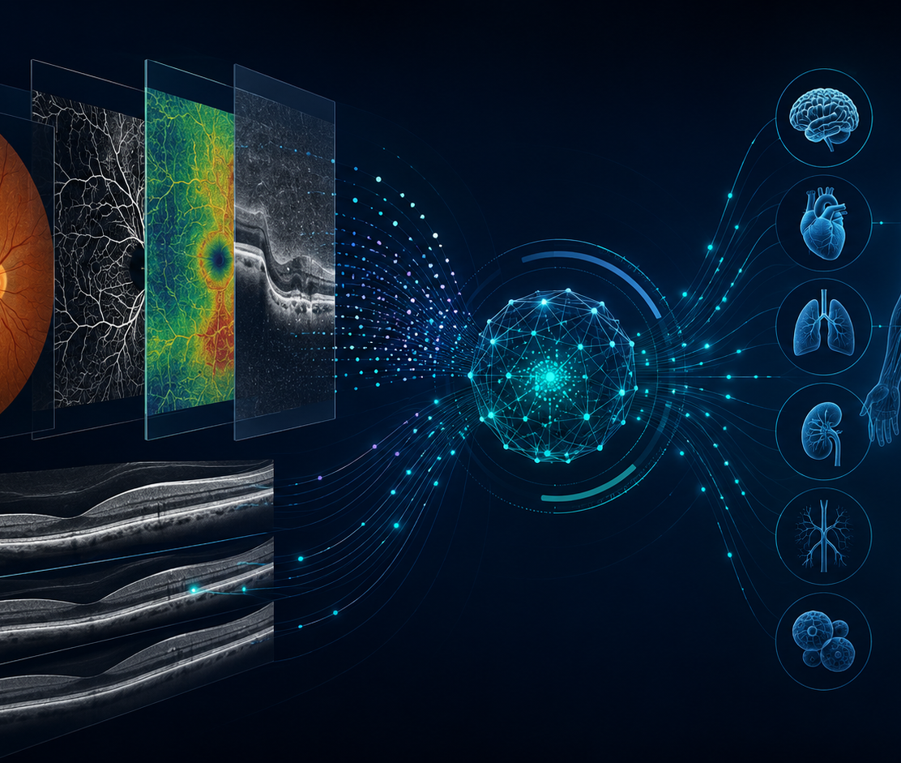
A new diagnostic surface
The retina is the only place where microvasculature and neural tissue are imaged routinely, non-invasively and repeatedly.
One scan
Many signals
Multiple products
Kidney · metabolism · vascular disease · brain health · ocular disease · trial enrichment
SpectOcular — Live Pitch · v5.1
3

Slide 4
First proof: renal signal
Renal is first because the answer can be tested now — on records we already have.
uACR / eGFR
1,400–2,500
Y4
Linked records first, prospective lab later
Pivotal range at an albuminuria endpoint
Authorization planning target
Renal is not the destination. It is the fastest way to prove SpectOcular can manufacture a systemic retinal biomarker.
SpectOcular — Live Pitch · v5.1
4

Slide 5
Why now
Five shifts make retinal biomarkers commercially executable now.
1
2
3
4
5
AI foundation models
Routine multimodal imaging
FDA AI pathways
Strategic OEM activity
Consent as the bottleneck
SpectOcular — Live Pitch · v5.1
5

Slide 6
What the market actually pays for
Two comparables define the strategy.
TOKU · COHORT-FIRST
CLAIRITY · AUTHORIZATION-FIRST
Two FDA Breakthrough designations — cardiovascular, and CKD risk in diabetics only
CE and UKCA marks; 4.3M linked retinal images
874-patient US prospective pivotal complete, presented at ACC 2026
Acquired by Topcon, Oct 2025 — price undisclosed, after raising ~$10.5M
Founded 2020. Built zero prospective cohort.
Mined 318,101 archived mammograms; outcomes from tumor registries
FDA De Novo authorization, May 2025
$43M Series B, Nov 2025 → ~$150–290M valuation, at year five
Public acquirers disclose material numbers.
Hit the milestone using outcomes that had already accrued.
SpectOcular's practices already hold years of retinal archives. The authorization, not the cohort, is the asset.
SpectOcular — Live Pitch · v5.1
6

Slide 7
The platform equation
Retina IQ installs the network. The network manufactures evidence. Evidence creates biomarkers.
Retina IQ
Network
Evidence
AI
FDA
Clinical wedge
Practices + workflow
Images + labs + records
Shared retinal model
Authorized biomarkers
The first authorization is proof that the engine works — not the endpoint.
SpectOcular — Live Pitch · v5.1
7

Slide 8
Two evidence engines
Speed from archives. Regulatory quality from prospective enrollment.
Archive engine
Prospective engine
Existing fundus + OCT archives → linkage test → discovery → external validation.
Contemporaneous labs + standardized imaging + diverse enrollment + biospecimen + re-contact.
SpectOcular — Live Pitch · v5.1
8

Slide 9
The multimodal edge
Fundus gives scale. OCT gives structure. OCT-A may reveal microvascular signal.
Fundus
OCT
OCT-A
Labs / Rx
Scalable deployment
Structural phenotype
Microvascular discovery
Fusion + benchmarks
The platform is valuable only if the signal survives external validation and adds value beyond cheap clinical variables.
SpectOcular — Live Pitch · v5.1
9

Slide 10
The AI flywheel
A shared retinal representation should make every next biomarker faster.
Encode
Fuse
Validate
Deploy
Self-supervised retina model
OCT + labs + Rx + records
Locked partitions + subgroups
FDA product back into network
Model governance is a product requirement, not an afterthought.
SpectOcular — Live Pitch · v5.1
10

Slide 11
Where SpectOcular wins
Two narrow claims that matter.
1. US multi-ethnic cohort
2. Re-contact rights
A well-characterized, diverse, properly consented US evidence package is the binding constraint for international competitors.
Large datasets cannot call participants back, re-image, re-consent or add biospecimens. SpectOcular can.
SpectOcular — Live Pitch · v5.1
11

Slide 12
Regulatory strategy
File the Q-Sub before the company spends real capital.
1
2
3
4
Reference standard
Case count
Diversity targets
De Novo vs 510(k)
Being second can be better: if Toku or Mediwhale opens the product code, SpectOcular may fast-follow with a better US diverse cohort.
SpectOcular — Live Pitch · v5.1
12

Slide 13
The portfolio path
One platform, many products — sequenced by evidence burden.
1
2
3
4
5
CKD detection
Diabetes / metabolic
Hypertension / vascular
Heart failure / stroke
Neuro / pharma
Start with fast reference standards. Move to progression. Save rare incident events for the mature cohort.
SpectOcular — Live Pitch · v5.1
13

Slide 14
The 90-day proof package
Under ~$250K to know whether the path is real.
0
1
2
3
Partner calls
FDA Q-Sub
UK Biobank fusion test
Archive linkage pilot
Two phone calls. One regulatory submission. Two data tests.
SpectOcular — Live Pitch · v5.1
14

Slide 15
Milestones that re-rate the company
Valuation follows evidence, not slide count.
Y1
Y2
Y3
Y4
Y5
Q-Sub + linkage
Pivotal readout
De Novo filed
Authorization
Launch + platform proof
Planning outcome: authorization in hand + first revenue + 25–60K linked re-contactable cohort = platform proof, not endpoint.
SpectOcular — Live Pitch · v5.1
15

Slide 16
Capital strategy
Raise only after each information advantage is visible.
Now
Next
Then
Pilot + archive test + Q-Sub with disciplined founder/practice support.
Non-dilutive pharma/OEM money where it does not lock the platform.
Equity after pilot/Q-Sub/archive facts improve valuation and preserve founder ownership.
SpectOcular — Live Pitch · v5.1
16

Slide 17
Why this founder
The first company advantage is credibility at the point of care.
Retina surgeon
Practice platform
OD network
Research credibility
IRB + consent architecture
Can launch now
SpectOcular — Live Pitch · v5.1
17

Slide 18
The ask
Help SpectOcular prove the engine — fast, cheaply and cleanly.
Pilot proof
Evidence proof
Platform proof
5–10 sites, consent workflow, data quality and CRLP.
Archive linkage + UK Biobank fusion + Q-Sub.
CKD first product, then repeatable biomarkers.
SpectOcular — Live Pitch · v5.1
18

Slide 19
The first authorization proves the platform.
The platform creates the company.
SpectOcular turns routine retinal imaging into a reusable engine for systemic biomarkers.
SpectOcular — Live Pitch · v5.1
19

